Slide 1


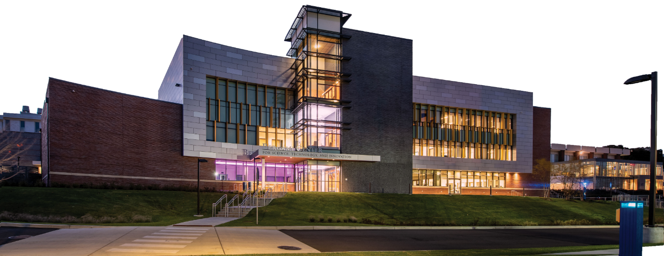
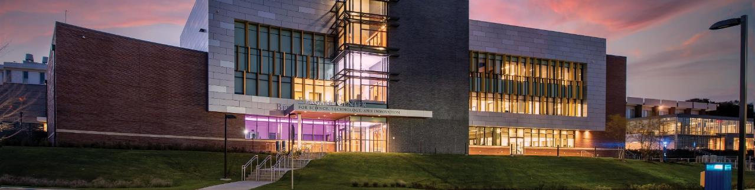
University of New Haven
PROJECT SHOWCASE
DSCI-6007-02 | TEAM 8

Slide 2
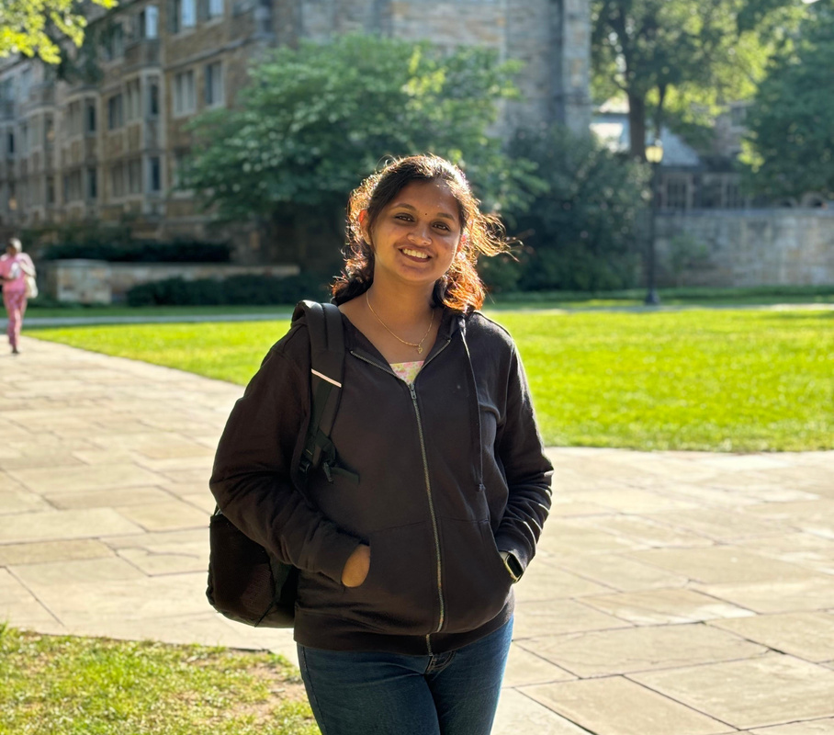


University of New Haven
TEAM MEMBERS
BIPIN PURI
Greeshma Chanduri
Erla venkata
Data Engineer
Data Scientist
Data Engineer

Slide 3
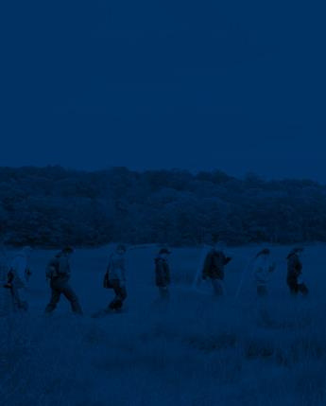

University of New Haven
INTRODUCTION
GOALS
PROJECT DETAILS
DATASET AND PREPROCESSING
ARCHITECTURE DIAGRAM
EXPECTED DELIVERABLES

Slide 4
University of New Haven
INTRODUCTION
Problem Statement: Predicting student academic performance for early intervention
Traditional Approach: Manual analysis with limited scalability and real-time capabilities
AWS Solution: Cloud-based machine learning pipeline for automated predictions
Business Impact: Enables personalized learning and proactive student support

Slide 5
University of New Haven
GOALS
Build Hybrid Ensemble Model: Combine Random Forest, XGBoost, and Neural Networks
Create Scalable Pipeline: Implement end-to-end AWS architecture for data processing
Develop User-Friendly Interface: Deploy Streamlit web application for real-time predictions
Ensure Cost Efficiency: Leverage serverless AWS services to minimize operational costs

Slide 6
University of New Haven
GOALS
Build Hybrid Ensemble Model: Combine Random Forest, XGBoost, and Neural Networks
Create Scalable Pipeline: Implement end-to-end AWS architecture for data processing
Develop User-Friendly Interface: Deploy Streamlit web application for real-time predictions
Ensure Cost Efficiency: Leverage serverless AWS services to minimize operational costs

Slide 7
University of New Haven
DATASET AND PREPROPROCESSING
Features:
- Demographic: Gender, age (15–22)
- Socioeconomic: Parent education, occupation
- Behavioral: Study time, absences, alcohol use
- Academic: G1, G2, final grade (G3)
Dataset Overview:
- UCI Student Performance Dataset
- 395 student records, 32 features
Target Variable:
- G3 binned into Low (0–9),
Medium (10–14), High (15–20)
Preprocessing:
- Label Encoding
- Normalization
- Train-Test Split (80%-20%)

Slide 8
University of New Haven
DATASET AND PREPROPROCESSING
Features:
- Demographic: Gender, age (15–22)
- Socioeconomic: Parent education, occupation
- Behavioral: Study time, absences, alcohol use
- Academic: G1, G2, final grade (G3)
Dataset Overview:
- UCI Student Performance Dataset
- 395 student records, 32 features
Target Variable:
- G3 binned into Low (0–9),
Medium (10–14), High (15–20)
Preprocessing:
- Label Encoding
- Normalization
- Train-Test Split (80%-20%)

Slide 9
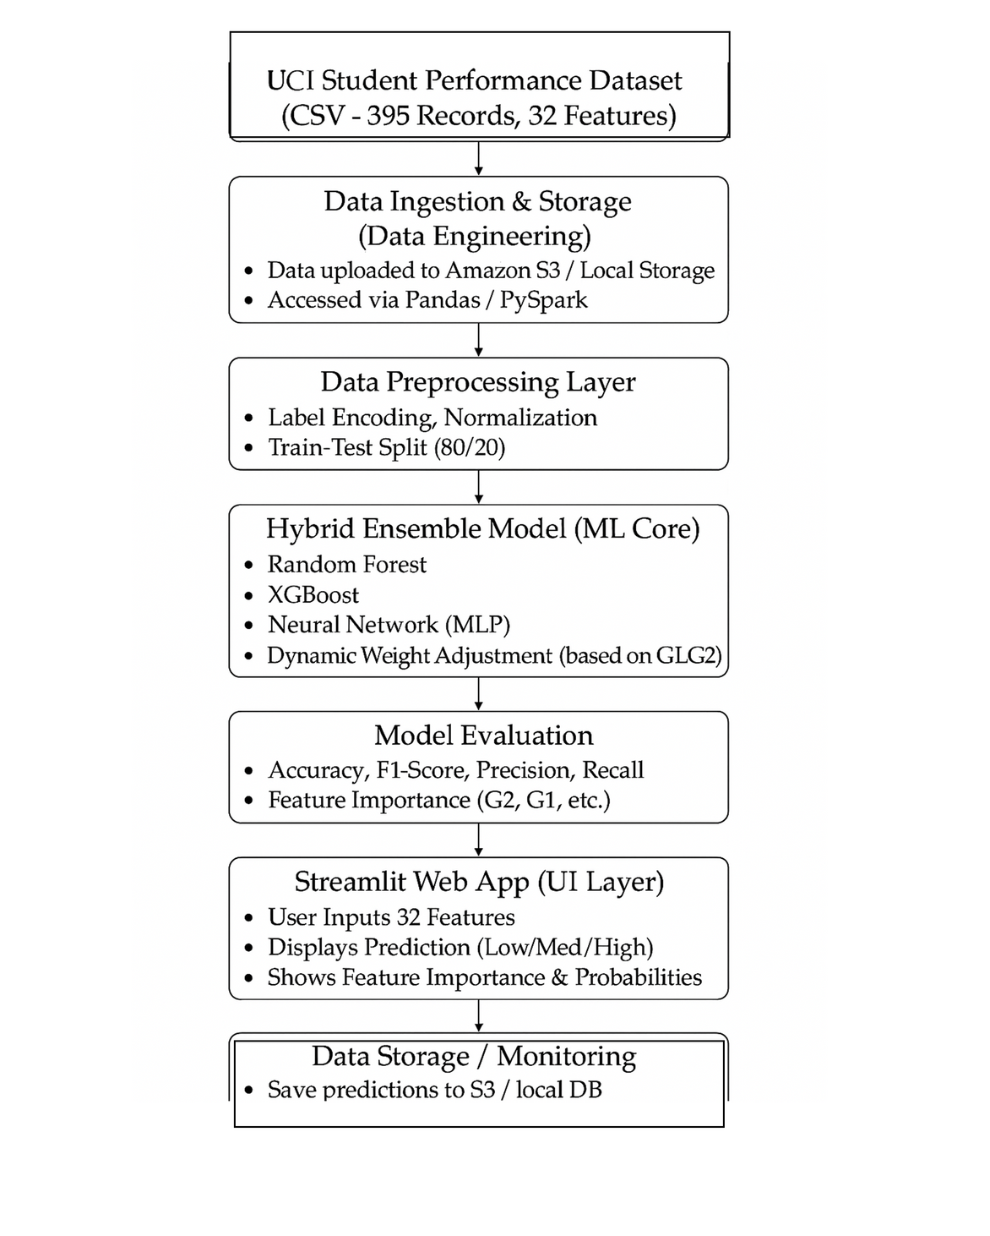
University of New Haven
ARCHITECTURE DIAGRAM OF THE SOLUTION

Slide 10
University of New Haven
ARCHITECTURE DIAGRAM OF THE SOLUTION

Slide 11
University of New Haven
EXPECTED DELIVERABLES
Functional Web Application with student performance prediction interface
Automated ML Pipeline handling data processing to model deployment
Cost-Optimized Solution leveraging AWS free tier and managed services

Slide 12
University of New Haven
EXPECTED DELIVERABLES
Functional Web Application with student performance prediction interface
Automated ML Pipeline handling data processing to model deployment
Cost-Optimized Solution leveraging AWS free tier and managed services
Gitub Link: https://github.com/phoneixvenkat/team-8.git

Slide 13
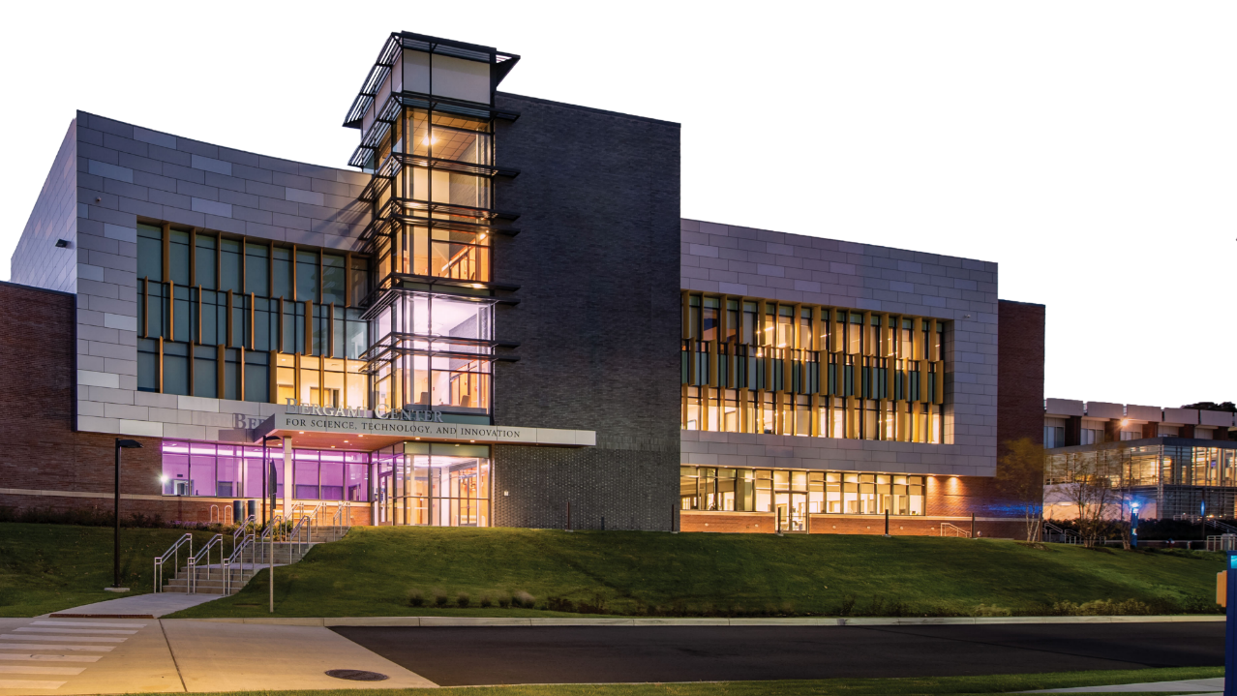

University of New Haven
‹#›
THANK YOU

